Slide 1

Team members: 1. T. Sabithapriya 2. T. Sharmila Rani 3. Y. Anil Kumar 4. M. Shanmukh Venkat Varshith
Comprehensive Digital Marketing
Project Work
On
Biotique

Slide 2
Part 1: Brand study, Competitor Analysis & Buyer’s/Audience’s Persona

Slide 3

Part 1: Brand study, Competitor Analysis & Buyer’s/Audience’s Persona
COMPANY/TOPIC for project: BIOTIQUE
Research Brand Identity: Study the brand's mission, values, vision, and unique selling propositions (USPs).
Brand colours :
White, Green
Logo :
Mission/Values:
Biotique mission is to satisfy the diverse beauty needs of customers and cultures who seek natural beauty products that are as effective as they are environmentally responsible.
USP: The USP of the Biotique brand being ayurvedic products that are made from 100 percent naturally sourced ingredients.

Slide 4
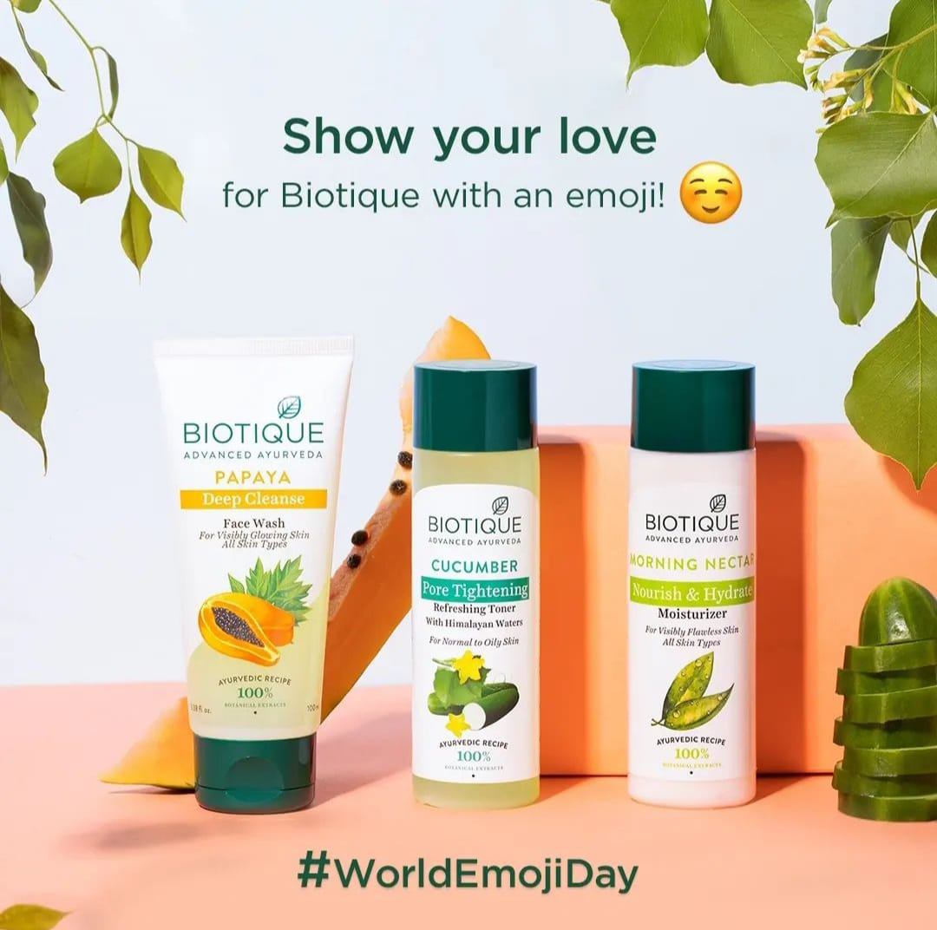

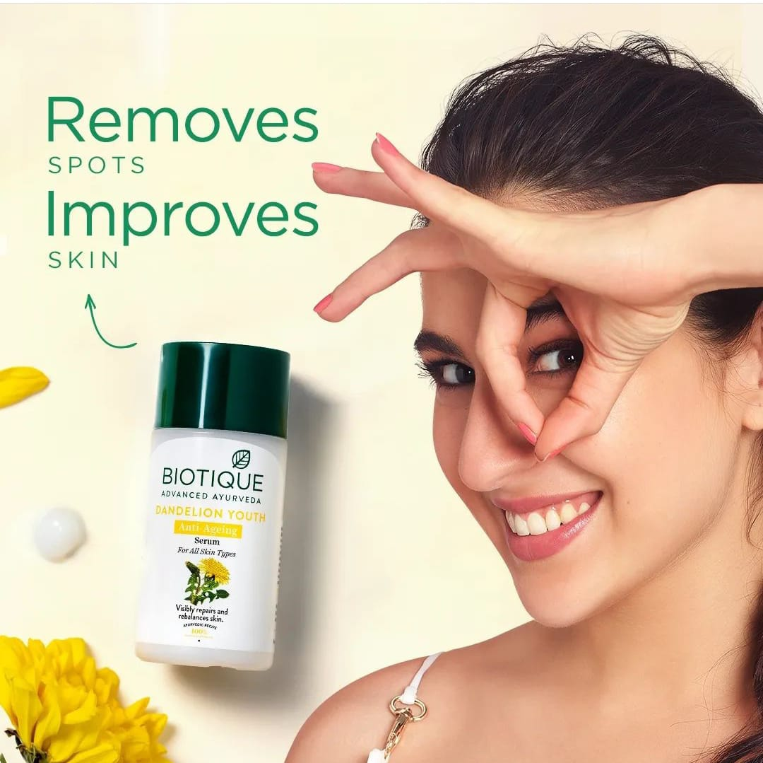
Analyze Brand Messaging:
Fun, Creative and Informative.
Examine the brand's tagline:
Indulge in the goodness of non-toxic beauty.
Examples: https://instagram.com/biotique_world?igshid=MzRlODBiNWFlZA==

Slide 5
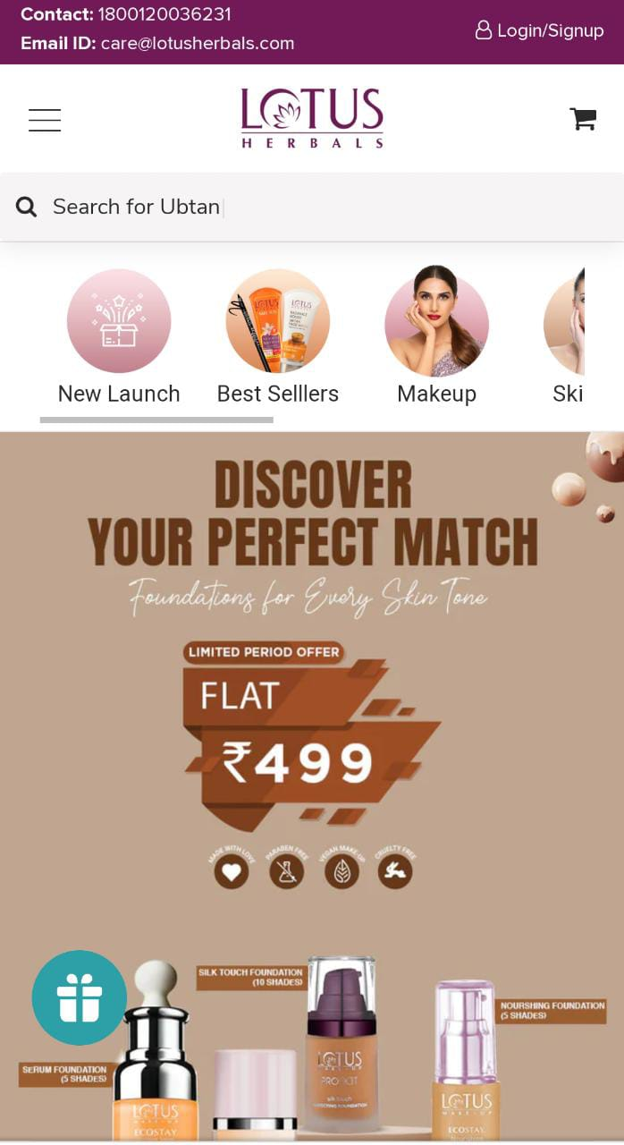
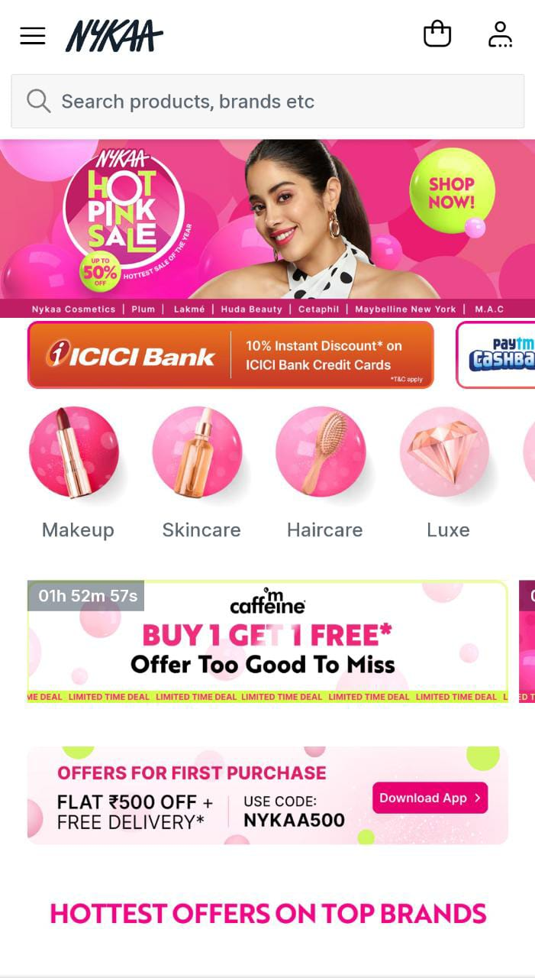
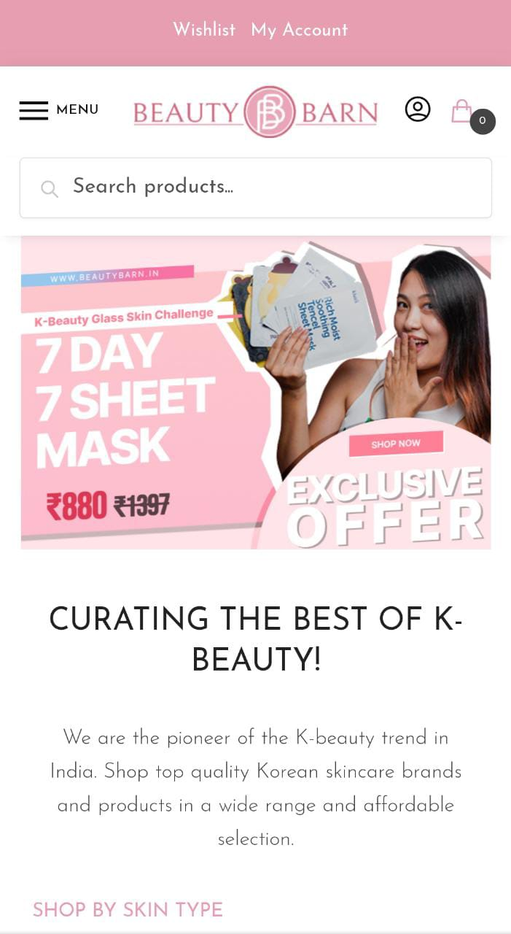
Competitor Analysis:
Competitor 1: https://www.lotusherbals.com
USP: Categorisation, offers, discounts, Tips.
Communication: Celebrity Endorsement, Content memes, Lots of tutorials.
Competitor 2: https://www.nykaafashion.com/
USP: Categorisation, Offers.
Communication: Tips and Tricks, Lots of tutorials, Celebrity Endorsement.
Competitor 3: https://www.beautybarn.in
USP: Categorisation, Offers, Brand collaboration.
Communication: Quizs, tutorials, tips.

Slide 6
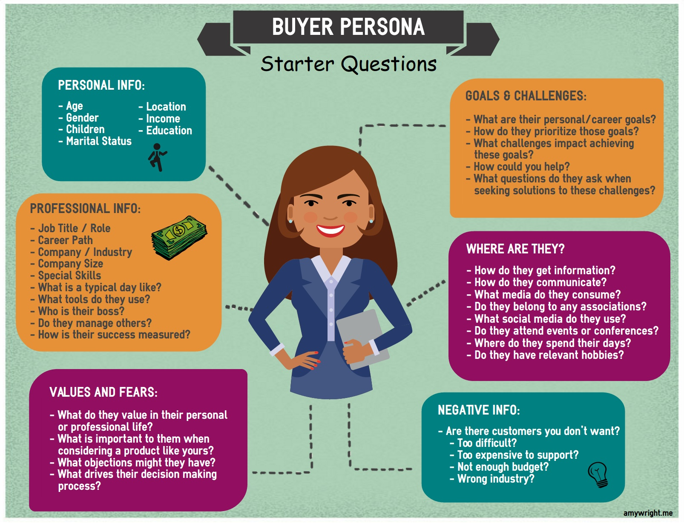
Buyer's/Audience's Persona:
Age : 18-45
Gender : All
Children : Yes
Martial Status : Married/Unmarried
Location : Urban/Rural
Income : 2,00,00er annum-20,00,000
per annum
Education : Not Specified
Interest : People who prefer
Ayurvedic
and Natural products
Marketing platforms : Google ads, Youtube ads,
television, Instagram,
Facebook, Twitter.

Slide 7
Part 2: SEO & Keyword Research

Slide 8
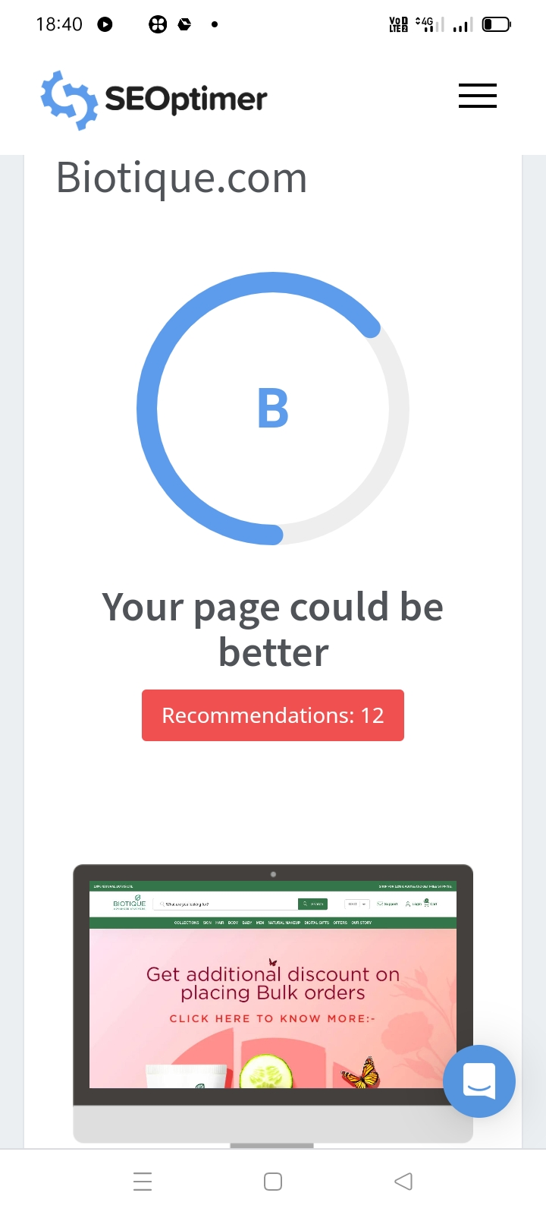
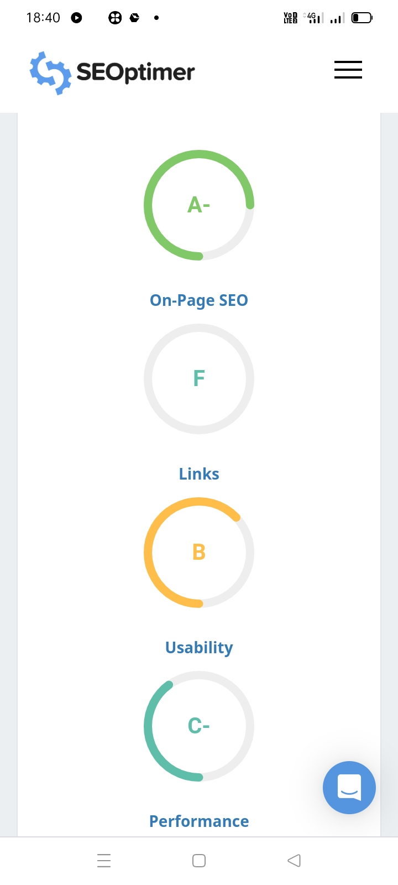
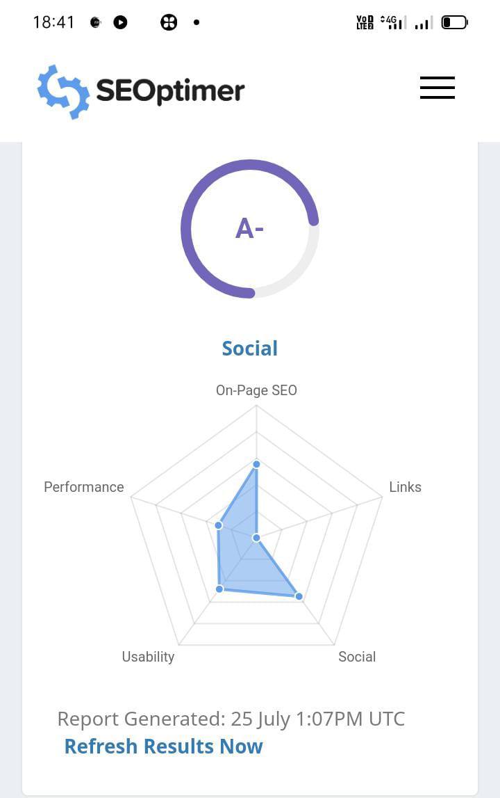
BIOTIQUE SEO AUDIT:
An SEO audit is the evaluating how well your website is optimised for search engines it identifies errors that can prevent your site from ranking well and opportunities that can help you rank better. An SEO audit usually covers areas like indexing and crawlability .
An SEO audit the process of analysing hoe well your web presents relates to best practises – it is the first step to creating an implementation plan that will have measurable results . The purpose of audit is to identify as many foundational issues affecting organic search performance as possible .

Slide 9
RESEARCH OBJECTIVE:
Biotique is a well-known Indian brand that specializes in Ayurvedic skincare and haircare products. However, research objectives for a company like Biotique could encompass a wide range of areas related to their products, business, and industry. Some possible research objectives might include:
Product Development and Improvement: Biotique may aim to conduct research to develop new skincare and haircare products based on traditional Ayurvedic principles or improve existing products based on customer feedback and scientific advancements.
Ingredient Studies: Research could be focused on studying the properties and effects of specific natural ingredients used in Biotique products, determining their efficacy, and finding potential new ingredients for future formulations.
Safety and Quality Assurance: Ensuring the safety and quality of their products is crucial. Research objectives may involve conducting tests and studies to validate the safety and stability of their formulations.
Consumer Behavior and Market Analysis: Understanding consumer preferences, needs, and behavior is essential for any business. Biotique might conduct market research to identify trends, assess customer satisfaction, and adapt their strategies accordingly.

Slide 10
BRAINSTROM SEED KEYWORDS:
SEED KEYWORDS
Biotique
Ayurvedic beauty products
Natural skincare
Herbal cosmetics
Biotique products
Organic hair care
Ayurvedic remedies
Herbal skincare
Biotique skincare routine
Botanical beauty products
Natural wellness products
Biotique hair care
Ayurvedic body care
Herbal remedies for skin

Slide 11
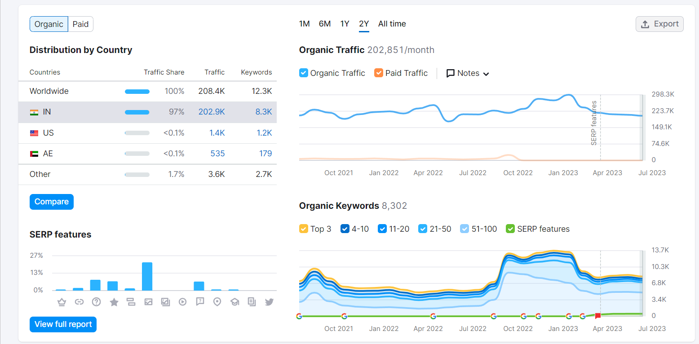
KEYWORD RESEARCH:
Keyword research is the process of finding and analysing search terms that people enter into search engines with the goal of using that data for a specific purpose, often for search engine optimization(SEO) or general marketing.
KEYWORD RESEARCH FOR BIOTIQUE:
The following are the relevant keywords of Biotique brand that have been found after thorough research and filtering.
These keywords are further filtered as per the high and low traffic, popularity and few other criteria based on the requirement of our research.

Slide 12
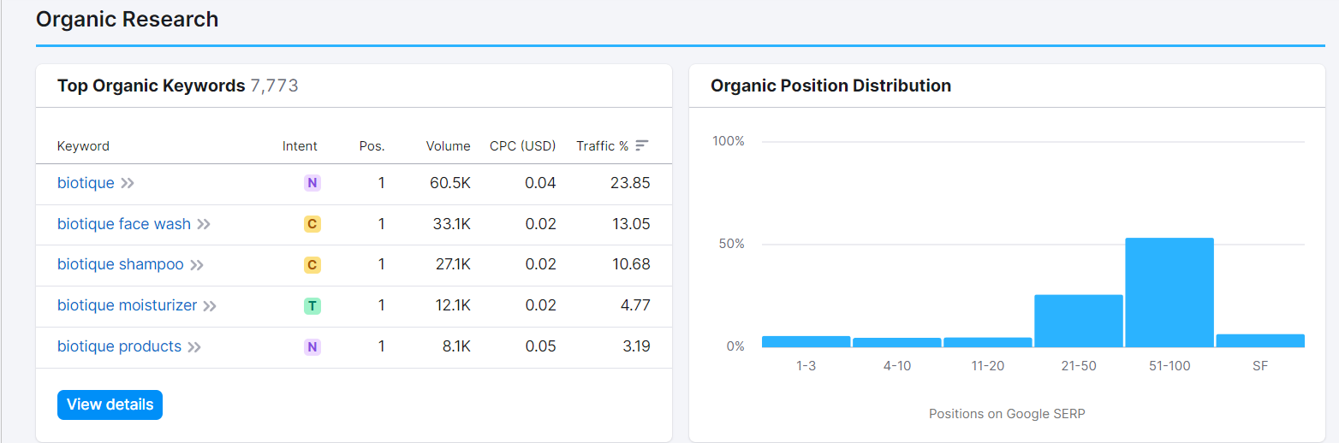
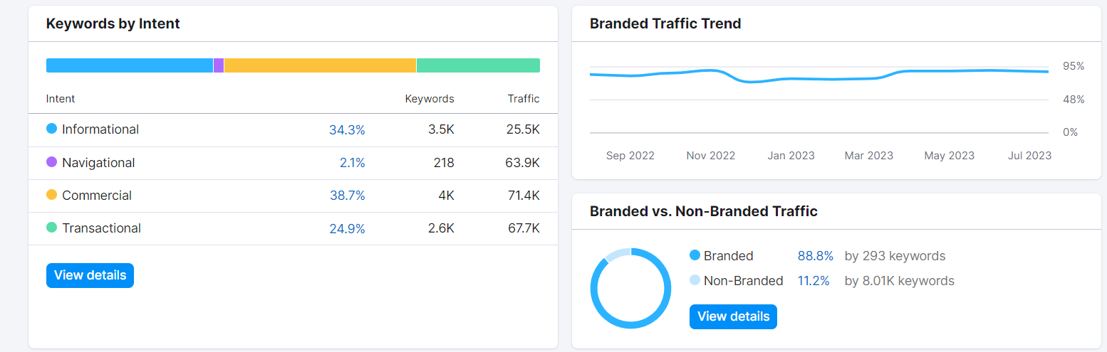

Slide 13
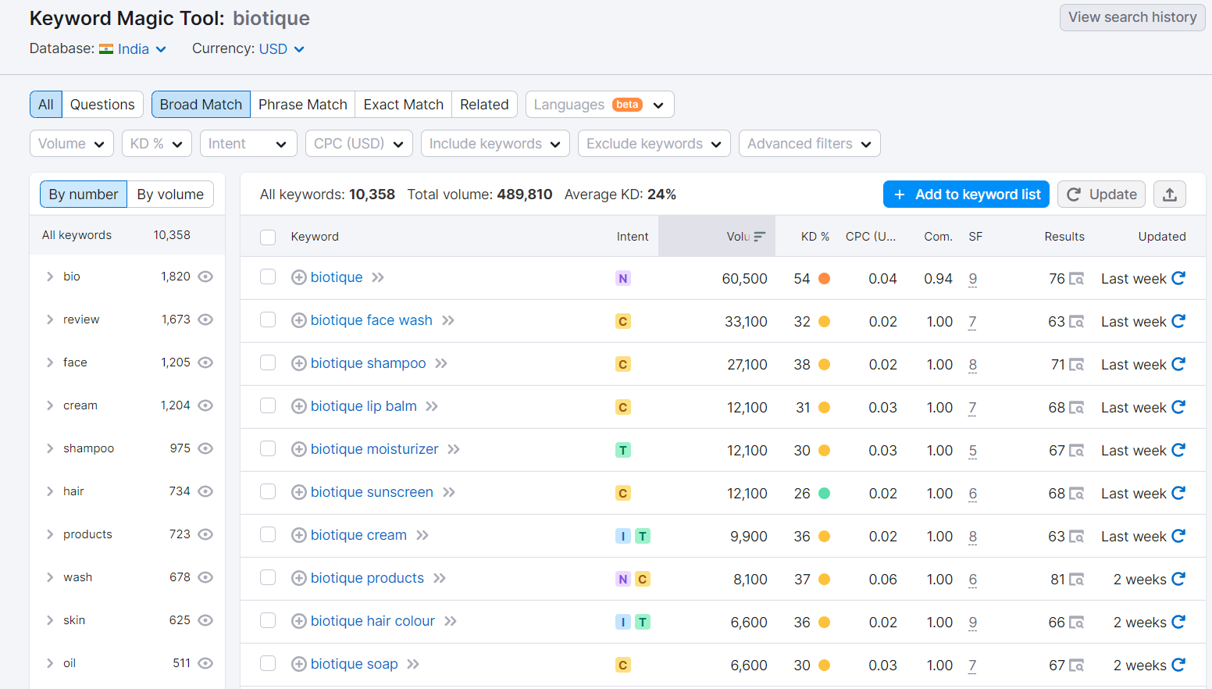
BIOTIQUE KEYWORDS:

Slide 14
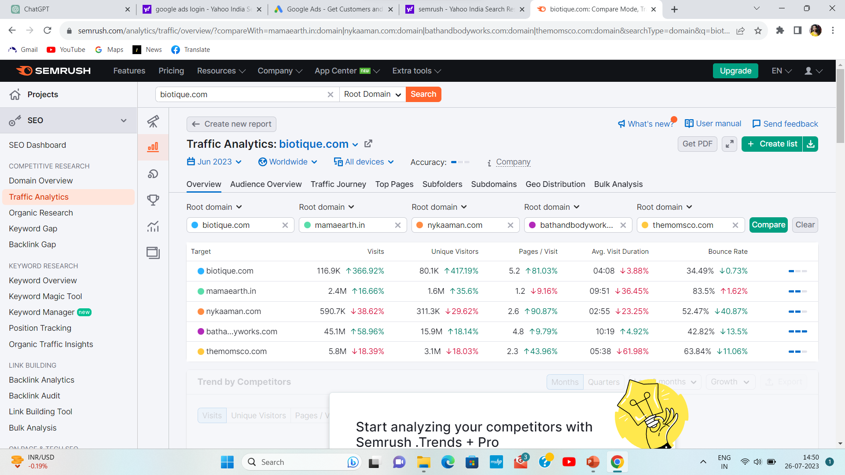
ANALYZE COMPETITOR KEYWORDS:

Slide 15
LONG-TAIL KEYWORD SEARCH:
LONG-TAIL KEYWORD SEARCH
Biotique organic skincare products
Biotique herbal shampoo reviews
Buy Biotique sunscreen online
Biotique anti-dandruff hair oil
Biotique natural face cleanser
Biotique ayurvedic skincare routine
Best Biotique products for acne-prone skin
Biotique hair growth treatment
Biotique baby care products
Biotique under-eye dark circle cream

Slide 16
ON-PAGE OPTIMIZATION:
Meta Tag Optimization for Biotique:
1. Title Tag: The title tag is one of the most crucial meta tags for SEO. It appears as the main headline in search engine results. Make sure to include relevant keywords related to Biotique's products, such as "Biotique skincare products," "Natural wellness by Biotique," etc. Keep it concise, around 50-60 characters, and compelling to attract clicks.
2. Meta Description: The meta description is a brief summary that appears below the title tag in search results. It should be around 150-160 characters and provide a compelling reason for users to click on the link. Include relevant keywords and highlight the unique selling points of Biotique's products or services.
3. Keywords: Conduct keyword research to identify the most relevant and commonly searched keywords related to Biotique and its products. Utilize these keywords naturally in your meta tags, as well as throughout the website's content.
4.Product-specific Meta Tags: For individual product pages, create unique and informative meta tags for each product. Include the product name, its unique benefits, and targeted keywords. Avoid using generic meta tags across all product pages.

Slide 17
CONTENT OPTIMIZATION FOR BIOTIQUE:
1. Understand the Audience: Conduct thorough research to understand the preferences, pain points, and interests of Biotique's target audience. Are they looking for skincare solutions, hair care, or overall wellness? Understanding their needs will help tailor the content accordingly.
2. Highlight Natural and Organic Benefits: Biotique's main selling point is its use of natural and organic ingredients. Emphasize this aspect in the content to attract eco-conscious and health-conscious consumers. Explain the benefits of these ingredients and how they can positively impact the users.
3. Educate and Inform: Create content that educates users about the importance of natural products and their impact on the environment and personal health. This can include blog posts, articles, and infographics explaining various beauty and wellness topics.
4. Product Descriptions: Craft compelling and detailed product descriptions that not only highlight the features but also the benefits of each product. Explain how these products can solve specific beauty or health concerns.

Slide 18
5. User-Generated Content: Encourage customers to share their experiences with Biotique products through reviews, testimonials, and social media posts. User-generated content adds authenticity and builds trust among potential customers.
6. Visual Appeal: Use high-quality images and videos to showcase the products, demonstrate their application, or share the behind-the-scenes story of Biotique's commitment to natural beauty.
7. SEO Optimization: Conduct keyword research to identify relevant search terms and incorporate them naturally into the content. This will improve Biotique's search engine visibility and organic traffic.
8. Leverage Social Media: Biotique's target audience is likely active on social media platforms. Utilize these channels to share engaging content, run contests, and collaborate with influencers to reach a wider audience.
9. Create How-to Guides and Tutorials: Educate customers on how to use Biotique products effectively. Step-by-step guides and tutorials can be valuable resources for users and can also showcase the brand's expertise.
10. Focus on Sustainability: Share Biotique's sustainability initiatives and practices through content. Consumers appreciate eco-friendly brands, and showcasing these efforts can foster a positive brand image.
11. Email Newsletters: Use email marketing to keep customers informed about new product launches, promotions, and beauty tips. Personalize the emails for a more engaging experience.

Slide 19
PROCESS OF CONDUCTING KEYWORD RESEARCH:
“Biotique" is a brand known for its Ayurvedic beauty and skincare products. Conducting keyword research is an essential step in any digital marketing strategy, including search engine optimization (SEO). Keyword research helps identify the terms and phrases potential customers use to find products or services, and it allows you to optimize your website and content to rank higher in search engine results, thus increasing organic traffic.
Here's a general process for conducting keyword research for Biotique or any brand:
Understand Your Target Audience: Define your target audience and understand their preferences, pain points, and interests. This information will help you find relevant keywords that align with their needs.
Brainstorm Seed Keywords: Begin by brainstorming a list of seed keywords relevant to Biotique's products, such as "Ayurvedic skincare," "natural beauty products," "organic cosmetics," etc. These seed keywords will be the foundation of your research.
Keyword Research Tools: Utilize keyword research tools to expand your list of keywords and gather valuable data. Some popular tools include:
Google Keyword Planner (free)
SEMrush
Ahrefs
Moz Keyword Explorer

Slide 20
4. Analyze Competitors: Look at the websites of competitors or similar brands to see which keywords they are targeting. This can give you ideas for additional keywords to include in your list.
5. Keyword Intent: Consider the intent behind each keyword. Are people looking for information, products, or solutions? Understanding the intent helps you align your content accordingly.
Keyword Relevance and Volume: Evaluate the relevance and search volume of each keyword. High search volume indicates more people are searching for that term, but it may also mean higher competition. Balance highly relevant, niche keywords with broader, high-volume ones.
Long-Tail Keywords: Long-tail keywords are longer and more specific phrases. They may have lower search volume but often lead to higher conversion rates. Incorporate relevant long-tail keywords into your strategy.
Keyword Difficulty: Assess the difficulty of ranking for specific keywords. Highly competitive keywords may be difficult for a new website to rank, so consider targeting some less competitive terms to start.
Organize and Prioritize Keywords: Categorize your keywords based on relevance and search volume. Create keyword groups or clusters around specific themes
10. Content Strategy: Develop content around your selected keywords. This can include product pages, blog posts, guides, and other relevant content that aligns with your target keywords.

Slide 21
Part 3: Content Ideas and Marketing Strategies

Slide 22
SUNDAY | MONDAY | TUESDAY | WEDNESDAY | THURSDAY | FRIDAY | SATURDAY
 |  |  |  |  |  | 1 NATIONAL DOCTOR’S DAY
2 WORLD UFO DAY | 3 | 4 | 5 | 6 | 7 | 8
9 | 10 | 11 WORLD POPULATION DAY | 12 | 13 | 14 | 15
16 | 17 WORLD DAY FOR INTERNATIONAL JUSTICE | 18 NELSON MANDELA INTERNATIONAL DAY | 19 | 20 | 21 | 22
23 | 24 NATIONAL THERMAL ENGINEER’S DAY | 25 NATIONAL REFRESHMENT DAY | 26 KARGIL VIJAY DAY | 27 | 28 WORLD HEPAPTITIS | 29 INTERNATIONAL TIGER DAY
30 | 31

Slide 23

CONTENT IDEAS:
BIOTIQUE: Our country has a long tradition of using scents and attar. In fact, we have strong roots and connections with fine fragrances. The kings and queens of ancient times used to have special penchant for fragrances that celebrate their personalities. Fragrances were also actively used
for worshipping gods right from the vedic age. It is believed that since fragrances
made from natural substances like flowers, woods and water, they deeply affect
our psyche.
Another reason why fragrances and perfumes are so popular in India
is because of our tropical climatic conditions. Heat and stickiness is almost
synonymous with summers in India, and we need to be very sure in our choice
of perfumes. We want our perfumes to not only give us great smell but also
helps us feel fresh throughout the day. Let’s have a look at some of the best
fragrances from Biotique that are not only authentic and grounded, but are also
cost effective, and extremely safe to use.
Fragrances evoke a whole new world. They awake our senses and uplift our personality. That’s why choosing fragrances is called an art. Hope you are able to get some idea of what our fragrances have to offer to you. All Biotique fragrances are organic and safe to use. So, stay fresh throughout the summer season and get your pick from these timeless elegant and juicy fragrances.

Slide 24
MARKETING STRATEGIES FOR BIOTIQUE:
ENGAGING ONLINE CAMPAIGNS:
Launch interactive online campaigns such as “Face wash flavour voting” or “creating face wash contests”, where consumers can vote for their favorite face wash or suggest their innovative combinations. So that we could know what type of facewashes people would love to try, which helps our brand to launch new stuff.
MEMES:
By creating memes on biotique hair products that helps people to know about the product. Cleverly designed memes can showcase the products use and detailed about the project benefits. It encourages the customers to share the memes with their friends or family members.
“Memes have the potential to go viral, which can significantly increase brand visibility and reach as users share and engage with the content.”

Slide 25
CONTENT MARKETING:
By creating valuable and relevant content to attract, engage, and retain a target audience. Blogs serve as a powerful tool within this strategy to achieve various marketing objectives.
By the journey of Biotique’s blog we could highlight the rich heritage of traditional marketing while exploring new products that resonate with modern consumers and many more.

Slide 26
CHALLENGES FACED IN CONTENT IDEAS AND MARKETING STRATEGIES:
1. Producing high-quality content
2. Generating content consistently
3. Prioritising content expertise
4. Understanding different buyer personas
5. Producing content in suitable formats
6. Measuring content ROI
7. Creating buy-in among stakeholders
8. Aligning content with the buyer journey
9. Activating content effectively
10. Choosing the right channels

Slide 27
Part 4: Content Creation and Curation

Slide 28
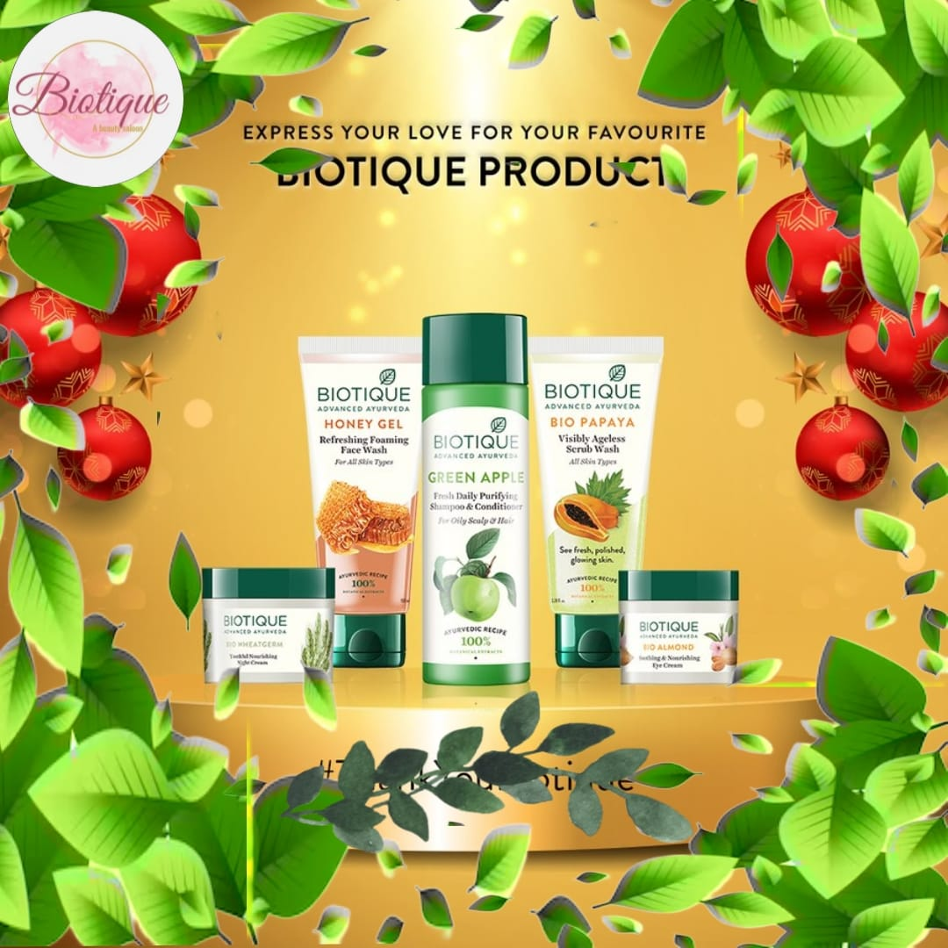
Format: 1 Creative:
Aim: To increase biotique brand visibility.
Date: 04-08-2023
Idea: To create a relatable and humorous connection with the target audience.

Slide 29
Format :2 Blog Article:
Aim: Boost SEO and provide information about biotique new product.
Date: 08-08-2023
Idea: Biotique has launched new Neem Facewash and this blog will cover the details about them by wash your face with Neem facewash .
Topic : To remove acne you can wash your face with Neem facewash .
Biotique’s Neem face wash helps to remove acne on face. It helps to get pimple clear face. Now a days acne is a common skin problem that affects individuals of all ages. The quest for clear, pimple clear skin often leads us to try various products but every product will not give good results . Generally acne facewashes contain harsh chemicals that can affect the skin of its natural oils and cause further irritations .
INGREDIENTS :
Biotique neem face wash was made with neem , ashwagandha and galangal . These are the 3 primary constituents in this face wash . Because of its powerful medicinal powers, neem has been admired. Neem act as acne-prone, anti-septic, anti-bacterial. This face wash contains neem its helps clear your skin of clogged pores and fight acne-causing bacteria.

Slide 30
Another important component is ashwagandha, which has powerful antioxidants that delay the ageing process of the skin. It works to reduce the appearance of fine lines, wrinkles, blemishes, and dark spots.
A very lesser-known plant, galangal is essential to better skin health. Because of its anti-inflammatory qualities, it can reduce swelling and redness. It helps to repair burned skin and removing acne causing bacteria .
BENEFITS OF USING BIOTIQUE’S NEEM FACE WASH:
Neem is a popular ingredient known for its numerous benefits. It helps for :
1. Acne treatment and prevention
2. Gentle and soap-free cleansing
3. Deep pore purification
4. Anti-Aging properities
5. Suitable for all skin types
Biotique neem face wash is an excellent product to the common problems of those who suffer from oily skin or acne-prone skin. The all-natural ingredients gently cleanse, nourish, and improve the look of your skin without causing any harm or unpleasant side effects.

Slide 31
TIPS TO ACHIEVE PIMPLE-FREE SKIN AT HOME:
1. Clean your face twice daily
2. Follow with a toner
3. Moisturise regularly
4. Exfoliate weekly
5. Maintain a healthy diet
CONCLUSION:
Biotique’s neem face wash is a great option if you are seeking an all-natural way to fight acne. This face wash is formulated with a special mixture of neem, ashwagandha, and galangal that not only purifies pores and removes makeup but also helps prevent and treat acne. You can finally wave goodbye to your acne issues and welcome a more confident you by including this mild and effective face wash into your skincare.

Slide 32
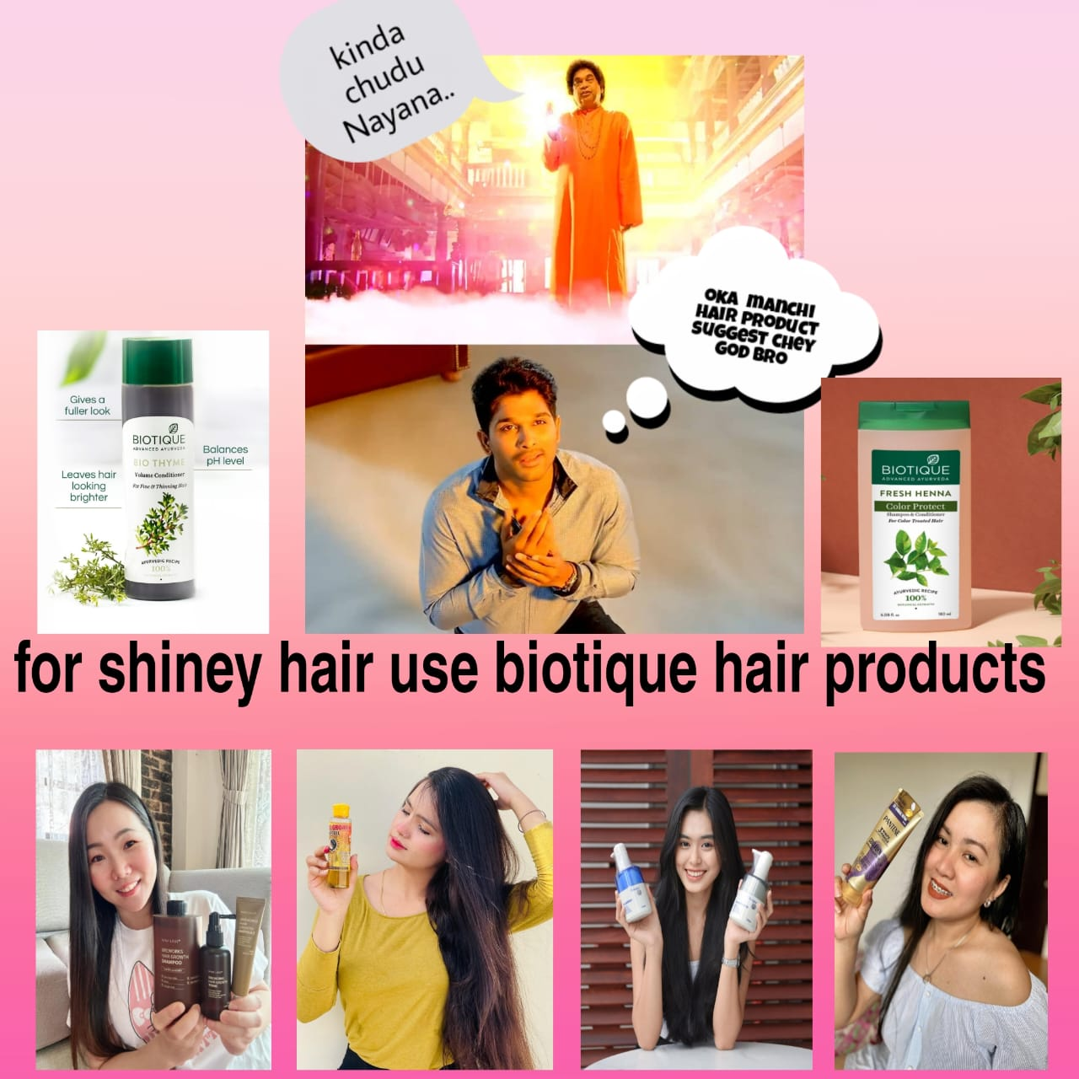
Format: 3 Creative:
Aim: Brand awareness and reach
Date: 16-08-2023
Idea: To create a meme.

Slide 33
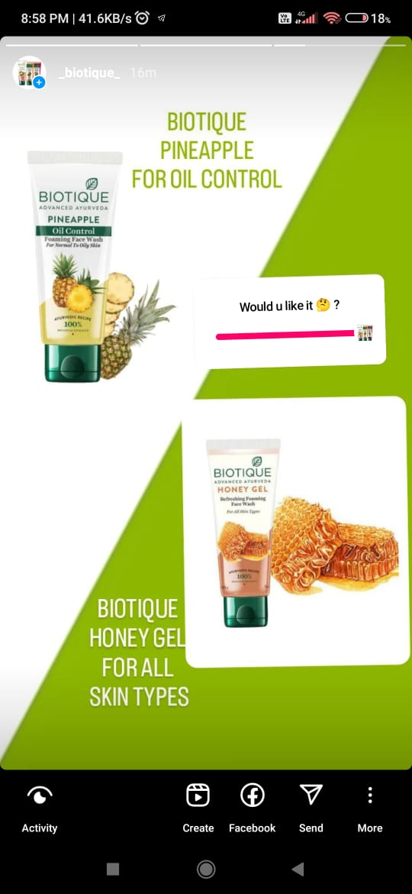
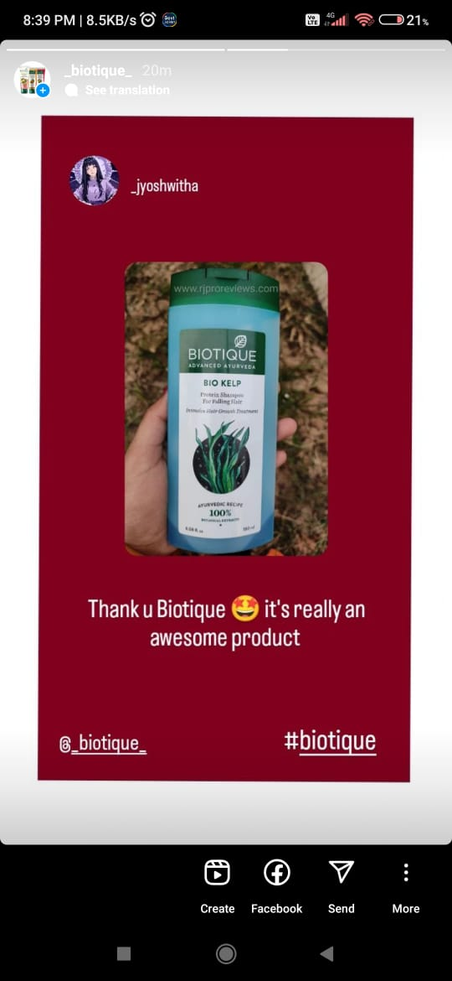
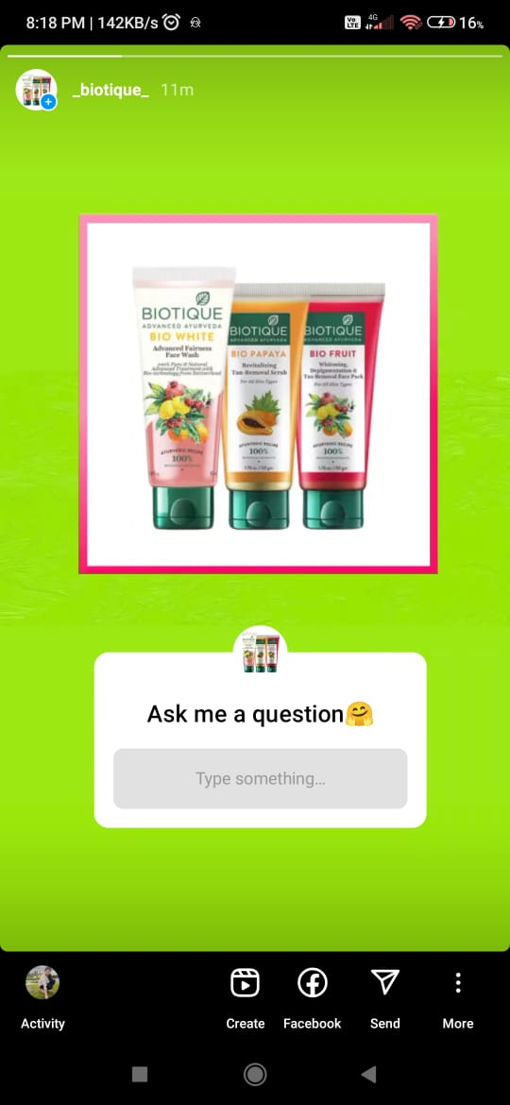
Instagram Story
Views: Views: Views:
Likes: Likes: Likes:
Polling result:

Slide 34

Designs/Video Editing

Slide 35
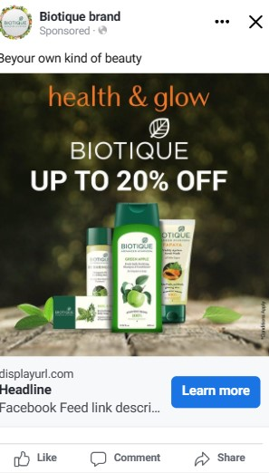
BRAND AWARENESS CAMPAIGNS: Targeting: Campaign objective: Awareness Location: India Age: 18-60+ Gender: All genders Performance goal: Maximise reach of ads Interests: Beauty salons, Cosmetics, Fragrances, Hair products Primary text: Health and glow
Social Media Ad Campaigns

Slide 36
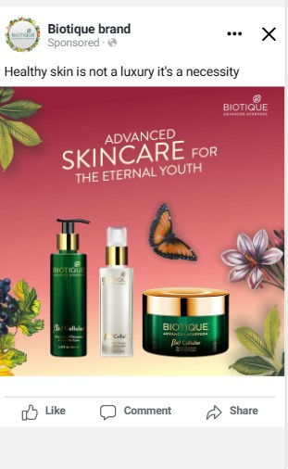
DRIVING WEBSITE TRAFFIC CAMPAIGN: Targeting: Campaign objective: Traffic Location: India Age: 18-60+ Gender: All genders Conversion location: Website Performance goal: Maximise number of conversions Daily budget: 800Rs Estimated reach: 4.2K-12K Estimated link clicks: 6-19 Interests: Beauty salons, Cosmetics, Fragrances, Hair products Primary text: Advanced skincare for the eternal youth

Slide 37
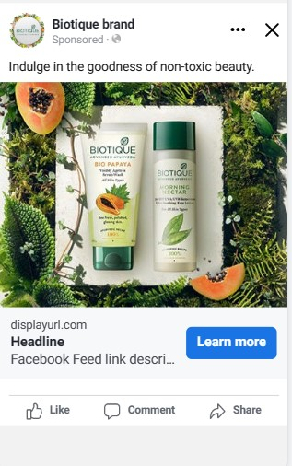
LEAD GENERATION CAMPAIGN: Targeting: Campaign objective: Leads Location: India Age: 18-60+ Gender: All genders Conversion location: Instant forms Performance goal: Maximise number of leads Daily budget: 800Rs Estimated reach: 2.3K-6.1K Estimated link clicks: 6-19 Interests: Beauty salons, Cosmetics, Fragrances, Hair products Primary text: Indulge in the goodness of non-toxic beauty.

Slide 38
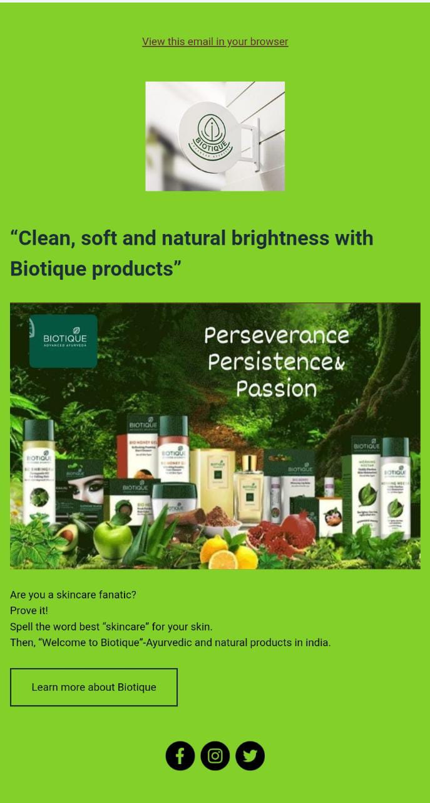
Email Ad Campaigns
Email Ad Campaign 1 - Brand Awareness

Slide 39
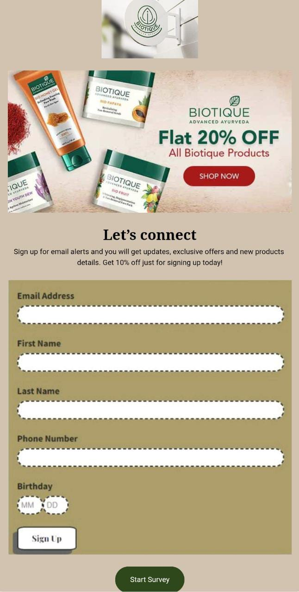
Email Ad Campaign 2 - Lead Generation

Slide 40
CHALLENGES IN CONTENT CREATION:
Consistency, audience relevance, originality, diversification, promotion, and adaption.
LESSONS LEARNED:
Plan content calender, conduct audience research, focus on quality, diversify formats, promote effectively, analyze feedback, stay relevant, balance SEO and creativity, and establish content governance. Improve content strategy with these insights.

Slide 41
THE END

